Slide 1
Notes:
Erasmus+ and its predecessors are among the most successful programmes of the European Union resulting from an initiative from the Commission.
For more than three decades, they have been offering opportunities to gain new experiences to young people in particular, and a chance to broaden their horizons by going abroad.
What started as a modest mobility scheme for higher education students back in 1987 – with only 3,200 students in its first year – has developed into a flagship programme benefiting around 300,000 higher education students per year, but not only.
Since 1987, about 9 million individuals from Europe and around the world have had the opportunity to undertake activities within or outside the EU in the fields of education, training, youth and sport. Participants are young people, students, adult learners, teachers, trainees, volunteers, youth workers.
The current Erasmus+ programme, running from 2014 to 2020, has a budget of €14.7 billion and will provide opportunities for 3.3 million young people in the EU to study, train, undertake non-formal learning and work-based learning experiences.
The geographical scope of the programme has expanded from 11 countries in 1987 to 33 currently (all 28 EU Member States as well as Turkey, the former Yugoslav Republic of Macedonia, Norway, Iceland and Liechtenstein). The programme is also open to partner countries across the world.
A proposal for a new Erasmus programme for the period 2021-2027 has been adopted by the Commission end of May 2018 and has been transmitted to the European Parliament and the Council. We hope for a timely adoption by the European co-legislator to have a seamless transition between the current and the next programme.*
* The statistics in the picture and the sentence on the decision-making process regarding the proposal on theErasmus programme will be updated according to needs and requirements.

Slide 2
Notes:
Erasmus+ and its predecessors are among the most successful programmes of the European Union resulting from an initiative from the Commission. For more than three decades, they have been offering opportunities to gain new experiences to young people in particular, and a chance to broaden their horizons by going abroad.
Since 1987, about 9 million individuals from Europe and around the world have had the opportunity to undertake activities within or outside the EU in the fields of education, training, youth and sport.
The current Erasmus+ programme, running from 2014 to 2020, has a budget of €14.7 billion.
Specific issues tackled by the programme include:
Promoting cooperation and mobility with the EU’s partner countries
Promoting adult learning, especially for new skills and skills required by the labour market
Encouraging young people to take part in European democracy
Supporting innovation, cooperation and reform
Reducing early school leaving
Reducing unemployment, especially among young people
The geographical scope of the programme has expanded from 11 countries in 1987 to 33 currently (All 28 EU Member States as well as Turkey, the former Yugoslav Republic of Macedonia, Norway, Iceland and Liechtenstein). The programme is also open to partner countries across the world.

Slide 3
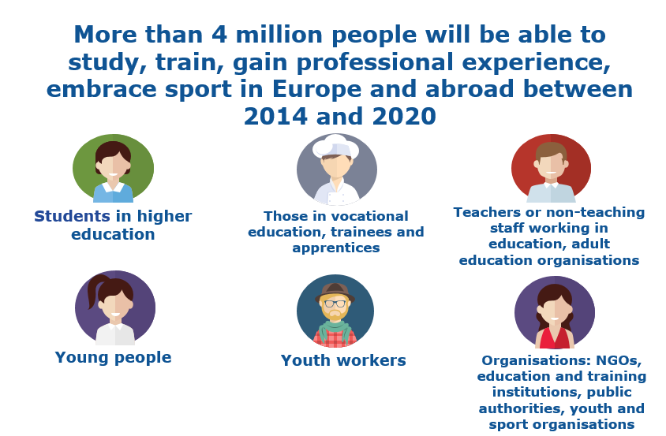
Notes:
Who can take part in Erasmus+ ?
Erasmus+ is open to many individuals and organisations. The programme provides opportunities for people of all ages, helping them develop and share knowledge and experience at institutions and organisations in different countries.
Participants are students, trainees, adult learners, teachers, young people, youth workers.
Study: Studying abroad is a central part of Erasmus+ and has been shown to have a positive effect on later job prospects. It is also a chance to improve language skills, gain self-confidence and independence and immerse yourself in a new culture. The strong international dimension of Erasmus+ provides many opportunities for participants to study worldwide.
Vocational education, trainees and apprentices: Erasmus+ helps you gain valuable experience in the workplace by supporting traineeships abroad. Erasmus+ support for traineeships is available for higher education students and recent graduates, as well as vocational education and training students, apprentices and recent graduates.
Teachers or non-teaching staff: Training opportunities are available to staff working in education, both in teaching and non-teaching capacities. Training periods abroad can consist of job shadowing, observation periods or specific training courses abroad. Opportunities are available to spend time teaching at an education institution abroad. These opportunities are available to both staff working in the education sector and to individuals working outside the sector invited to share their knowledge and experience.
Young people: Erasmus+ is open to all young people, not just those currently enrolled in education or training. With Erasmus+, you can participate in a youth exchange across Europe and abroad, train, undertake non-formal learning and work-based learning experiences. The strong focus of Erasmus+ on improving young people’s job prospects is essential to tackle youth unemployment.
Youth workers: Erasmus+ supports the professional development of youth workers through training or networking periods abroad. Periods abroad can consist of training courses, study visits, job shadowing or observation periods at relevant organisations and more.
Organisations: Finally, Erasmus+ provides opportunities for a wide variety of organisations including universities, education and training providers, think-tanks, research organisations, and private businesses.
Organisations that participate in Erasmus+ mainly facilitate the learning mobility opportunities for students, education staff, trainees, apprentices, young people and youth workers. They may also engage in the development and networking activities, including strategic improvement of the professional skills of their staff, organisational capacity building, and creating transnational cooperative partnerships with organisations from other countries in order to produce innovative outputs or exchange best practices.

Slide 4
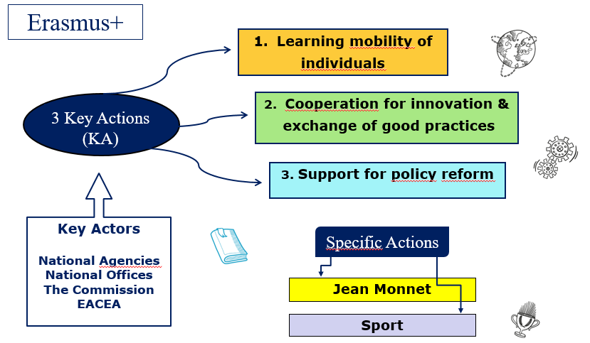
http://ec.europa.eu/programmes/erasmus-plus/contact/national-agencies_en
Notes:
How does Erasmus+ work?
Three Key Actions are the cornerstones of the implementation of the Erasmus+ programme.
Key Action 1: Learning mobility of individuals
Key Action 1 aims to encourage the mobility of students, staff, volunteers, youth workers, and young people. Organisations can arrange to send or receive students and staff to or from participating countries, as well as organise teaching, training, learning and volunteering activities.
Key Action 2: Innovation and good practices
Key Action 2 is designed to develop the education, training, and youth sectors through diverse activities. It supports joint initiatives/alliances to promote cooperation, peer-learning and sharing experience.
Key action 2 fosters innovation in and through education together with businesses (knowledge alliances) for new approaches to teaching and learning, entrepreneurship and the modernization of higher education systems in Europe. Key action 2 creates opportunities to modernise vocational education and training, to exchange knowledge and best practices, encourage working abroad, and increase the recognition of qualifications. It also supports the creation of IT-platforms including e-twinning and the cooperation with countries outside the EU.
Key Action 3: Support for policy reform
Key Action 3 aims to increase the participation of young people in democratic life, especially in discussions with policy makers, as well as developing knowledge in the fields of education, training, and youth.
In addition to the 3 Key Actions, the Erasmus+ programme has 2 specific actions: Jean Monnet and Sport Jean Monnet offers opportunities for teaching, research, and policy debate on the EU and its policies. It aims at promoting excellence in teaching and research on EU studies around the world.
It is also designed to foster dialogue between academic and policy-makers on EU policies. It promotes active citizenship, EU integration and dialogue between people and cultures.
Sport is designed to develop and implement joint activities to promote sport and physical activity, to identify and implement innovative activities in the field of sport. Sport Action is also designed to manage not-for-profit events to increase participation in sport. Sport opportunities tackle threats to the integrity of sport, promote dual careers for athletes, improve good governance, and foster tolerance and social inclusion.
Who does what?
To bring Erasmus+ as close as possible to the participants and make sure it works well across different countries, the Commission works in cooperation with National Agencies and National Offices. There are National Agencies in all EU countries and National Erasmus+ Offices in countries outside the EU. Their role is to promote the Erasmus+ programme and provide information on its opportunities, but not only. The National Agencies also select the projects to be funded, support applicants and participants, work with other National Agencies and the Commission, monitor and evaluate Erasmus+ programme implementation. The majority of the projects managed by the National Agencies are implemented on a national, regional or local level and focus on an exchange between countries.
The Commission and the Education, Audiovisual and Culture Executive Agency (EACEA) in Brussels also directly manage large and more strategic Erasmus+ projects designed to tackle specific issues throughout Europe.
For further information on how the Erasmus+ programme is managed and the application process, I invite you to consult the Erasmus+ website where there are dedicated pages on who does what and how.

Slide 5
Erasmus+
http://ec.europa.eu/erasmus-plus
Notes:
Here are a few fact findings concerning the Erasmus+ programme:
Green: The main motivation of young people to use Erasmus+ exchanges is to gain valuable work experience abroad.
Red: Unemployment rate is just under one-quarter lower for young people who have studied or trained abroad with Erasmus+.
Blue – center: Regarding work opportunities, one third of Erasmus+ trainees are offered a position by the company they trained in.
Light green: Concerning social inclusion, one third of mobility participants come from a disadvantaged background.
Light blue – bottom: Finally, one fact that isn’t very well-known: Erasmus+ also helps to address match-fixing and doping in sports.
I hope the presentation provides you with an insight into the opportunities of the Erasmus+ programme and will .
For further information on Erasmus+, I invite you to visit the Erasmus-plus website on ec.europa.eu
You may also contact the National Agency or the National Erasmus+ office in charge of Erasmus+ programme in your country.
Thank you for your attention.

Slide 6
#EUSOLIDARITYCORPS
europa.eu/solidarity-corps
Notes:
The European Solidarity Corps is the new European Union initiative which creates opportunities for young people to volunteer or work in projects in their own country or abroad that benefit communities and people around Europe.

Slide 7
Who?
Young people aged 18-30
What?
Volunteering, traineeships and jobs in areas such as social work and integration, environment, culture, education and other
How long?
Up to 12 months
How?
Young people register
Organisations search for suitable candidates
Young people can apply for advertised opportunities
Register at: europa.eu/solidarity-corps
Notes:
Registration is easy - dedicated webpage via the European Youth Portal, provide personal data, specify the areas of interest, choose occupational activities, subscribe to the Corps mission Statement; free to accept or reject offers
Corps mission statement - based on core EU values, such as solidarity, respect for human dignity and human rights, and the promotion of a fair and equal society in which pluralism, non-discrimination, tolerance, justice, solidarity and equality prevail. Participants will contribute to enhancing solidarity between people, while respecting their cultures and their traditions.
Registration does not guarantee a placement with a project.
Once participants have registered, organizations will be able to access their profile and contact candidates for solidarity projects.
NGOs, national and local authorities, private companies can participate but all have to comply with high quality standards and subscribe to the European Solidarity Corps Charter.
Participants will receive a Corps Certificate after finalizing a placement. It will prove their involvement in a European-wide undertaking to address societal challenges and their commitment to make a change.
All participants will have an employment contract (or a written traineeship agreement).
Occupational placements will be paid by the employer.
EU funding will cover financial support to travel (travel and accommodation to do an interview, relocation allowance and return travel allowance). Actual cost coverage covered by EU funding will vary from case-to-case. Additional allowance for young people with special needs.
In the case of a job, the wage conditions will be set in accordance with laws, regulations and collective agreements that are in force in the country where the job is situated (including minimum wage regulations).

Slide 8
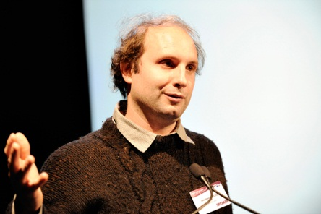
Marie Skłodowska-Curie Actions Training and career development for researchers
ec.europa.eu/msca
Doctoral training
Post-doc Fellowships
Staff exchanges
Science festivals
Nurturing excellence in research
International mobility
Academia and business
Good working conditions
Notes:
The Marie Skłodowska-Curie actions (MSCA) provide grants for all stages of researchers' careers - be they doctoral candidates or highly experienced researchers - and encourage transnational, intersectoral and interdisciplinary mobility. The MSCA enable research-focused organisations (universities, research centres, and companies) to host talented foreign researchers and to create strategic partnerships with leading institutions worldwide.
The MSCA aim to equip researchers with the necessary skills and international experience for a successful career, either in the public or the private sector. The programme responds to the challenges sometimes faced by researchers, offering them attractive working conditions and the opportunity to move between academic and other settings.
The MSCA are open to all domains of research and innovation, from fundamental research to market take-up and innovation services. Research and innovation fields are chosen freely by the applicants (individuals and/or organisations) in a fully 'bottom-up' manner.

Slide 9
Youth unemployment
Youth unemployment in the EU % of work force 15-24
Notes:
In 2017 the youth unemployment rate in the EU fell to its lowest level since 2013.

Slide 10
Youth Guarantee
Member States have committed to ensure that all young people up to the age of 25 receive (within four months of becoming unemployed or leaving education) a good quality offer of:
Funding
Job
Apprenticeship
Traineeship
Continued education
ESF
4
months
YEI
National budgets
Youth Guarantee Implementation Plans
Notes:
The Youth Guarantee has become a reality across the EU and has helped to improve the lives of millions of young Europeans.
More than 5 million young people have registered in YG schemes each year since 2014.
Since 2014, each year more than 3.5 million young people registered in the YG took up an offer of employment, continued education, a traineeship or an apprenticeship.
What is the Youth Guarantee?
Launched by the Commission, the Youth Guarantee is a political commitment taken by all EU Member States in April 2013 (in the form of a Council Recommendation) to give every person under the age of 25 a good-quality offer of employment, continued education, an apprenticeship or a traineeship within a period of four months of becoming unemployed or leaving formal education.
The Youth Guarantee covers all young people not in employment, education or training (NEETs).
The coordination of national Youth Guarantee schemes falls in most cases upon the ministry in charge of labour, while public employment services generally act as the main entry point. Alternative providers (including chambers of commerce, industry and crafts, youth centres, education institutions and providers and municipalities) are involved in about one third of Member States, and young people can register through specific online Youth Guarantee platforms in three Member States. Member States had to develop Youth Guarantee Implementation Plans, setting out how they plan to implement their national Youth Guarantee scheme.
While a majority of Member States target young people under the age of 25 as set out in the Council Recommendation, 13 Member States have extended coverage to target those under the age of 30. In most Member States, the time limit for delivering an offer is set at four months, in line with the Council Recommendation.
Typical examples of Youth Guarantee offers include:
1.open labour market employment (subsidised or not), self-employment supported through start-up and dedicated subsidies;
2.education opportunities including job-related training, reinsertion into the regular education system, bridging courses supporting this reinsertion, second chance education;
3.apprenticeships; and
4.traineeships.
While implementation of the Youth Guarantee lies mostly in the hands of the Member States, the European Union can support their efforts. The Commission is doing this by organizing mutual-learning events, supporting some Member States via peer reviews and monitoring the implementation of the Youth Guarantee within the process of the European Semester.
In addition, the Youth Employment Initiative was launched three years ago, which is a financial tool to support the implementation of the Youth Guarantee with a total of EUR 8.8 billion. In addition, the roll-out of the Youth Guarantee is supported by the ESF and national budgets.
Results of the Youth Guarantee
Four years on from when the Youth Guarantee took off, young people’s labour market performance has improved significantly:
- Youth unemployment has dropped from a peak of 24.4 % in 2013 to 16.8 % in 2017;
- And the share of 15-24 year olds not in employment, education or training has fallen from 13.2% in 2012 to 10.9% in 2017.
There are almost 2 million fewer young unemployed in the EU and 1 million less young people not in employment, education or training (NEETs).
The Youth Guarantee has significantly facilitated structural reforms and innovation in policy design across EU Member States. In 2013-2015, Member States adopted a total of 132 labour market measures targeting young people, highlighting a strong focus on youth employment policies.

Slide 11
The Youth Employment Initiative
2014 – 2015 € 6,4 billion
2017 – 2020 € 2,4 billion
For the regions with 25% youth unemployment
Notes:
The Youth Employment Initiative (YEI) is one of the main EU financial resources to support the implementation of Youth Guarantee schemes. It was launched to provide support to young people living in regions where youth unemployment was higher than 25% in 2012. It was topped up in 2017 for regions with youth unemployment higher than 25%in 2016.
The Youth Employment Initiative exclusively supports young people who are not in education, employment or training (NEETs), including the long-term unemployed or those not registered as job-seekers. It ensures that in parts of Europe where the challenges are most acute, young people can receive targeted support. Typically, the YEI funds the provision of:
apprenticeships
traineeships
job placements
further education leading to a qualification
The YEI supports the implementation of the Youth Guarantee. Under the Youth Guarantee, Member States should put in place measures to ensure that young people up to the age of 25 receive a good quality offer of employment, continued education, an apprenticeship or a traineeship within four months of leaving school or becoming unemployed.
The Youth Employment Initiative is complementary to other actions undertaken at national level, supported in particular by the European Social Fund (ESF), that aim to implement youth guarantee schemes. The ESF can reach out beyond individuals, helping reform employment, education and training institutes and services.
The total budget of the Youth Employment Initiative (for all eligible EU Member States) is €8.8 billion for the period 2014-2020. The initial budget of 2014-2015 was €6.4 billion; however, in September 2016, given the still high levels of youth unemployment, the Commission proposed to increase this budget . In June 2017, the Council and the Parliament agreed to an increase of the YEI by €2.4 billion for eligible Member States for the period 2017-2020
Of the total budget of €8.8 billion, €4.4 billion comes from a dedicated Youth Employment budget line, which is complemented by €4.4 billion more from ESF national allocations. The ESF contribution is topped up by the eligible Member States' own financial resources. The YEI is implemented in accordance with ESF rules.
In order to mobilise faster YEI actions on the ground, substantial funding was released to Member States in the form of pre-financing, which in 2015 was exceptionally increased to 30% of the special YEI budget line.

Slide 12
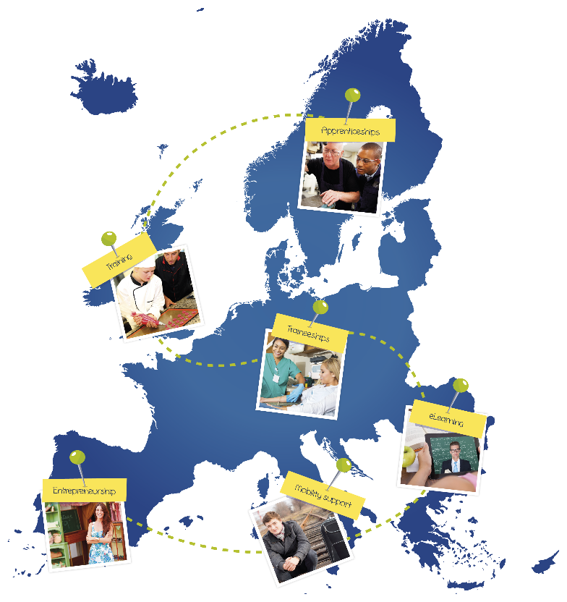
2. Job opportunities
Your first EURES job
Drop’pin@EURES
Youth
opportunities
Age group:18– 35 years
eures.europa.eu/droppin
Watch the video
How does it work?
www.eures.europa.eu
Notes:
Are you...
aged 18-35?
a national and legal resident of an EU Member State, Norway or Iceland?
unable to find a job or training opportunity in your country?
willing to relocate to another EU Member State, Norway or Iceland for a job, traineeship or apprenticeship?
If so, then Your first EURES job could be the solution for you.
What's in it for me?
Your first EURES job is a European Union job mobility scheme to help young EU citizens to find a job, traineeship or apprenticeship opportunity in another EU country, Norway or Iceland and to help employers find qualified workforce. It aims to match young jobseekers with remunerated employment offers across Europe. Placements must have a duration of at least 6 months (for jobs and apprenticeships) or 3 months (for traineeships).
Through Your first EURES job you can receive information, job search, matching and recruitment assistance. You may also be eligible for financial support to attend an interview abroad, as well as to cover costs such as language training, recognition of qualifications or relocation to the destination country.
What qualifications do I need?
Your first EURES job is open to candidates with different levels of education and/or work experience.
How can I take part?
The Your first EURES job guide sets out the conditions and rules governing participation.
Please find below the links to the lead employment services and their partner employment services offering the scheme. If your country does not yet offer these services or some country web links are not active, you can contact the lead employment services.
For more details, you can also consult the Your first EURES job list of employment services and their partners at EU level.
Drop’pin@EURES is the place where companies and organisations can promote and showcase their youth opportunities designed to help young Europeans take their first steps into the labour market. Opportunities on this online platform include apprenticeships, traineeships, training programmes, e-learning courses, language training, mobility support, coaching and mentoring etc.
Whatever kind of opportunity you’re looking for to improve your chances of finding a job in Europe, Drop’pin@EURES has something for you.
Drop’pin@EURES also facilitates matching of youth opportunities with the right young person’s profile by granting access to a large number of skilled jobseekers across Europe. On the platform, employers are able to find the perfect match by browsing CVs of potential candidate online. The tool additionally allows organisations to directly and easily post youth opportunities on the portal, which can be seen by young EURES members from all over Europe.”

Slide 13
The European Programme for Employment and Social Innovation (EaSI)
The EaSI Microfinance and Social Entrepreneurship axis aims at supporting quality employment including for young people through entrepreneurial initiatives.
By increasing access to, and the availability of, finance, the EaSI programme enables the first steps in your entrepreneurial pathway!
Notes:
EaSI Programme
a) EaSI programme:
To promote employment and social inclusion in Europe in line with policy goals of the Europe 2020 strategy
Three axis:
PROGRESS: the modernisation of employment and social policies
EURES: job mobility
Microfinance/Social Entrepreneurship: access to micro-finance and social entrepreneurship
b) Microfinance and Social axis:
Why focusing on entrepreneurship?
Micro-enterprises: 90% of new enterprises in EU and decisive for job creation
Social enterprises and microfinance: a way for disadvantaged groups into employment
Target groups: vulnerable groups (young, unemployed, women, migrants, people with disabilities), micro- and, social enterprises
Tools: financial instruments, technical assistance, European Code of Good Conducts
How does it work?
The EaSI programme, under the Microfinance and Social Entrepreneurship axis, is a financing instrument at EU level aiming financial institutions to help them:
increasing access to, and the availability of, microfinance
building up the institutional capacity of microcredit providers
supporting the development of the social investment market and facilitate access to finance for social enterprises
By supporting specialised financial institutions, the Commission objective is to increase their capacity to reach vulnerable entrepreneurs, micro- and social enterprises in order to help them start-up and develop their businesses.
Financial Instruments
The EaSI programme responds to the market demand through the use of a variety of financial instruments adapted to different needs on the ground. These include guarantees, debt and equity financing. http://www.eif.org/what_we_do/microfinance/easi/
EaSI Microfinance and Social axis in numbers
Budget: 196m EUR
Final recipients reached as at 30/09/2017: 25,829

Slide 14
Quality and effective apprenticeships everywhere
Notes:
Commission adopts initiative to boost apprenticeships in Europe, the Council follows with a recommendation on 15 March 2018
Today (5 October 2017) the European Commission has adopted a proposal for a European Framework for Quality and Effective Apprenticeships. This initiative is part of the New Skills Agenda for Europe, launched in June 2016. It also ties in with the European Pillar of Social Rights, which foresees a right to quality and inclusive education, training and life-long learning. The Commission has identified 14 key criteria that Member States and stakeholders should use to develop quality and effective apprenticeships. This initiative will help increase the employability and personal development of apprentices and contribute towards a highly skilled and qualified workforce responsive to labour market needs.
Vice-President for the Euro and Social Dialogue, in charge of Financial Stability, Financial Services and Capital Markets Union, Valdis Dombrovskis: "Taking on an apprenticeship is often the necessary stepping stone for a young person to be propelled into his or her career. Today we come with proposals to further improve this valuable training experience, so it benefits both employers and learners. While respecting the diversity of education and training systems in Member States, our ultimate goal is to facilitate the integration of young people in the labour market."
Vice-President for Jobs, Growth, Investment and Competitiveness, Jyrki Katainen said: "By providing direct links between theory and practice, between education and the labour market, quality and effective apprenticeships are concrete ways to help young people to enter the world of work and stand strong in life, whilst strengthening Europe's human capital. This is key to boosting the competitiveness of our societies and economies."
Commissioner for Employment, Social Affairs, Skills and Labour Mobility, Marianne Thyssen, said: "We want to make sure that young people learn the skills they need for work. Apprenticeships are the 'Gold Standard' in vocational education and training. Two out of three apprentices move straight into jobs after finishing their education. With today's new framework, we define what makes apprenticeships shine. Once adopted, the framework will ensure that both learners and employers benefit from quality apprenticeships."
To assess the quality and effectiveness of an apprenticeship, the proposed Framework proposes seven criteria for learning and working conditions:
(1) Written contract; (2) Learning outcomes; (3) Pedagogical support; (4) Workplace component; (5) Pay and/or compensation; (6) Social protection; (7) Work, health and safety conditions.
The Framework also proposes seven criteria for framework conditions:
(8) Regulatory framework; (9) Involvement of social partners; (10) Support for companies; (11) Flexible pathways and mobility; (12) Career guidance and awareness raising; (13) Transparency; (14) Quality assurance and graduate tracking.
The Commission supports the implementation of these criteria through relevant EU funding. The European Social Fund alone contributes up to 27 billion euros to education and training, and the EU supports apprenticeships also through various other instruments. In addition, the European Alliance for Apprenticeships has so far mobilised over 750,000 places for young people. At least 390,000 apprenticeships have already been offered under the Youth Guarantee. Erasmus+ supports mobility for apprentices, including a new ErasmusPro initiative aimed at supporting 50,000 placements of vocational learners in companies abroad for the period 2018-2020. As efforts are bearing fruit to expand the number of apprenticeships, it is vital to know what the criteria for success are. This is what the new Framework provides.
Background
Apprenticeships, a combination of learning in school and training in a workplace, ease the transition of young people from education and training into work. Today, there are around 3.7 million apprenticeship students in Europe.
Some Member States have very long and effective traditions regarding apprenticeships whilst others are in the process of establishing or strengthening their apprenticeship systems.
Overall, 60-70% of apprentices move into a job directly following their apprenticeship, and in some cases this increases to 90%.
The proposal for a European Framework for Quality and Effective Apprenticeships contributes to the EU's priority on jobs, growth and investment. It is part of the New Skills Agenda for Europe and its ambition to improve the quality and relevance of skills formation. One of the priorities is to make vocational education and training a genuine first choice for more people.
This proposal comes in the political context of the Rome Declaration of 25 March 2017, where European leaders pledged to work towards a “Union where young people receive the best education and training and can study and find jobs across the continent”.
The initiative also contributes to the realisation of the European Pillar of Social Rights, which states as a first principle that everyone has the right to quality and inclusive education, training and life-long learning.
The proposed initiative is also a follow-up to the 2016 Communication on Investing in Europe's Youth, in which the Commission announced its intention to propose such a Framework for Apprenticeships. It builds on important contributions from the European Social Partners.
This initiative complements Commission's initiates to strengthen Vocational Education and Training (VET), namely the existing Quality Framework for Traineeships.
Next steps
The proposal will be discussed by Member States with a view to it being adopted by the Council. The Commission is already preparing a new set of support services to help Member States and stakeholders implement this Framework through knowledge sharing, networking and peer-learning activities.
This initiative will also be promoted through the European Alliance for Apprenticeships and awareness raising campaigns such as the European Vocational Skills Week, which is taking place for the second year and will be organised from 20 to 24 November 2017.
More information

Slide 15
4. Skills for the future
For students and recent graduates, incl. teachers
Notes:
The Digital Opportunity is a pilot project that will provide cross-border traineeships for up to 6,000 students and recent graduates in 2018-2020. The Digital Opportunity trainees will strengthen their digital skills in fields like cybersecurity, big data, quantum technology, machine learning, digital marketing and software development. The first traineeships will start in June 2018 and the interns will receive an allowance of around 500 EUR per month. The pilot project will be financed by Horizon 2020 and implemented through Erasmus+.

