Slide 1
THE EUROPEAN COMMISSION: THE EU'S POLITICAL EXECUTIVE
#IntoEU

Slide 2
What do you know about the Commission?

Slide 3
The European Commission
1
2
3
is the political executive
acts as a college
promotes the general interest of the Union
Notes:
The European Commission:
Political executive:
- The European Commission is the EU's political executive arm.
2) Principle of collective responsibility (also called: collegiality):
- Decisions and actions by Commissioners are based on collective responsibility.
- In general, decisions by Commissioners are made by consensus, but votes by simple majority can also take place.
- All Commissioners are equal in the decision-making process and equally accountable for these decisions.
A Commssioner's profile:
- National of one EU Member State
- Competence in his/her portfolio
- European commitment
- Fully independent
3) General interest of the Union:
- The Commission promotes the general interest of the EU and takes appropriate initiatives to that end. (Lisbon Treaty, Art. 17)
- The Commissioners all swear a solemn declaration at the Court of Justice to be completely independent and to respect the EU treaties.

Slide 4
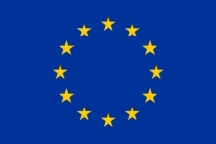
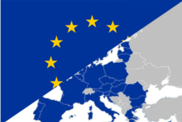
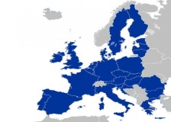
Division of competences
COMPETENCES
EXCLUSIVE
SHARED
SUPPORTING
Trade
Competition
- Agriculture
- Environment
- Tourism
- Education
Notes:
Division of competences within the European Union
SUMMARY
The EU has only the competences conferred on it by the Treaties (principle of conferral). Under this principle, the EU may only act within the limits of the competences conferred upon it by the EU countries in the Treaties to attain the objectives provided therein. Competences not conferred upon the EU in the Treaties remain with the EU countries. The Treaty of Lisbon clarifies the division of competences between the EU and EU countries.
These competences are divided into 3 main categories:
exclusive competences;
shared competences; and
supporting competences.
3 main types of competences
Exclusive competences (Article 3 of the Treaty on the Functioning of the European Union — TFEU) areas in which the EU alone is able to legislate and adopt binding acts. EU countries are able to do so themselves only if empowered by the EU to implement these acts. The EU have exclusive competence in the following areas:
customs union;
the establishing of competition rules necessary for the functioning of the internal market;
monetary policy for euro area countries;
conservation of marine biological resources under the common fisheries policy;
common commercial policy;
conclusion of international agreements under certain conditions.
2. Shared competences (Article 4 of the TFEU): the EU and EU countries are able to legislate and adopt legally binding acts. EU countries exercise their own competence where the EU does not exercise, or has decided not to exercise, its own competence. Shared competence between the EU and EU countries applies in the following areas:
internal market;
social policy, but only for aspects specifically defined in the Treaty;
economic, social and territorial cohesion (regional policy);
agriculture and fisheries (except conservation of marine biological resources);
environment;
consumer protection;
transport;
trans-European networks;
energy;
area of freedom, security and justice;
shared safety concerns in public health matters, limited to the aspects defined in the TFEU;
research, technological development, space;
development cooperation and humanitarian aid.
3. Supporting competences (Article 6 of the TFEU): the EU can only intervene to support, coordinate or complement the action of EU countries. Legally binding EU acts must not require the harmonisation of EU countries’ laws or regulations. Supporting competences relate to the following policy areas:
protection and improvement of human health;
industry;
culture;
tourism;
education, vocational training, youth and sport;
civil protection;
administrative cooperation.
Special competences
The EU can take measures to ensure that EU countries coordinate their economic, social and employment policies at EU level.
The EU’s common foreign and security policy is characterised by specific institutional features, such as the limited participation of the European Commission and the European Parliament in the decision-making procedure and the exclusion of any legislation activity. That policy is defined and implemented by the European Council (consisting of the Heads of States or Governments of the EU countries) and by the Council (consisting of a representative of each EU country at ministerial level). The President of the European Council and the High Representative of the Union for Foreign and Security Policy represent the EU in matters of common foreign and security policy.
Exercise of competence
The exercise of EU competences is subject to two fundamental principles laid down in Article 5 of the Treaty on European Union:
proportionality: the content and scope of EU action may not go beyond what is necessary to achieve the objectives of the Treaties;
subsidiarity: in the area of its non-exclusive competences, the EU may act only if — and in so far as — the objective of a proposed action cannot be sufficiently achieved by the EU countries, but could be better achieved at EU level.
Examples:
Trade:
The EU is the world’s biggest trader, accounting for 16.5% of the world's imports and exports. Free trade among its members was one of the EU's founding principles, and it is committed to liberalising world trade as well.
Trade - a global system
World trade is founded on rules laid out by the World Trade Organisation that help ensure that trade agreements and obligations between countries are open and fair.
EU trade policy is made exclusively at EU level. The Commission negotiates agreements on behalf of the EU within WTO rules and works closely with national governments and the European Parliament to maintain the global system and enable it to adapt to worldwide changes.
Trading as a world leader
The EU is the world's biggest exporter of manufactured goods and services, and it is the biggest import market for over 100 countries.
It is also the world's largest single market area. Both European and international consumers and investors enjoy the many benefits of a simplified system – in an area where people, goods, services and money can move freely.
Building a fair and open playing field
The EU negotiates agreements through its world-wide network of trade relations. It engages with a huge range of partners, mostly through free trade agreements.
These partnerships seek to create growth and jobs for Europeans by opening new markets with the rest of the world. Transatlantic markets, for example, represent transactions worth around 2 billion euros every day.
EU trade policy also aims to reduce child and forced labour, environmental destruction and price volatility. Schemes which ensure transparency and traceability in supply chains are one example.
For the world's poorest countries, EU trade policy looks to combine trade and development. Allowing lower duties, supporting small export businesses, and advising on improvements to governance are just some of the ways trade and development can work hand in hand to ensure the neediest benefit from trade-led growth.
Competition:
The EU's rules on competition are designed to ensure fair and equal conditions for businesses, while leaving space for innovation, unified standards, and the development of small businesses.
Under EU rules, businesses cannot:
fix prices or carve up markets amongst themselves
abuse a dominant position in a particular market to squeeze out smaller competitors
merge –if doing so would put them in a position to control the market.
In practice this rule only prevents a small number of mergers going ahead. Larger companies that do a lot of business in the EU cannot merge without prior approval from the European Commission – even if they are based outside the EU.
Protection for small firms
Large firms are barred from using their bargaining power to impose conditions that would make it difficult for their suppliers or customers to do business with their competitors. The Commission can (and does) fine companies for this practice, because it leads to higher prices and/or less choice for consumers.
EU investigations into anti-competitive practices cover not only goods but also professions (doctors, lawyers, etc.) and services – including financial services, such as retail banking and credit cards.
No props for lame duck companies
The Commission also monitors how much assistance EU governments give to businesses (‘state aid’), for example:
loans and grants
tax breaks
goods and services provided at preferential rates
government guarantees which enhance the credit rating of a company compared to its competitors.
The risk with such assistance is that it may favour well-connected vested interests, at the expense of those who compete on their own merits – with the bill footed by the taxpayer. Reining in such undeserved subsidies is a cheap and effective way to make Europe fairer and promote economic growth.
Flexible rules
These rules are applied with common sense and flexibility. The main consideration is whether consumers will benefit or other businesses will be harmed. For example, governments are allowed to help firms in difficulty – or new ventures – if they have a real chance of eventually being profitable, and so saving, even creating, jobs. What is not allowed is help for ailing businesses that have no hope of being viable.
Other exceptions to the general rules include:
companies working together on a single technical standard for the market as a whole
smaller companies cooperating, so they can compete better with larger ones
research and innovation initiatives
regional development projects
Checks and balances
The Commission's extensive powers to investigate and halt violations of EU competition rules are subject to a number of internal checks and balances, as well as full judicial review by the European Courts. Companies and EU governments regularly lodge appeals against Commission decisions, which are sometimes successful.

Slide 5
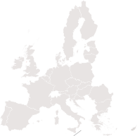
EU law
Primary Legislation
Secondary Legislation
Non-binding
Binding
RECOMMENDATION
REGULATIONS
DIRECTIVES
DECISIONS
/
Economic
governance
Roaming
Consumer
rights
Microsoft
Notes:
EU treaties
The European Union is based on the rule of law. This means that every action taken by the EU is founded on treaties that have been approved voluntarily and democratically by all EU member countries. For example, if a policy area is not cited in a treaty, the Commission cannot propose a law in that area.
A treaty is a binding agreement between EU member countries. It sets out EU objectives, rules for EU institutions, how decisions are made and the relationship between the EU and its member countries.
Treaties are amended to make the EU more efficient and transparent, to prepare for new member countries and to introduce new areas of cooperation – such as the single currency.
Under the treaties, EU institutions can adopt legislation, which the member countries then implement.
EU law is divided into 'primary' and 'secondary' legislation. The treaties (primary legislation) are the basis or ground rules for all EU action.
Secondary legislation – which includes regulations, directives and decisions – are derived from the principles and objectives set out in the treaties.
The aims set out in the EU treaties are achieved by several types of legal act. Some are binding, others are not. Some apply to all EU countries, others to just a few.
1) Regulations
A "regulation" is a binding legislative act. It must be applied in its entirety across the EU. For example, when the EU wanted to make sure that there are common safeguards on goods imported from outside the EU, the Council adopted a regulation.
2) Directives
A "directive" is a legislative act that sets out a goal that all EU countries must achieve. However, it is up to the individual countries to devise their own laws on how to reach these goals. One example is the EU consumer rights directive, which strengthens rights for consumers across the EU, for example by eliminating hidden charges and costs on the internet, and extending the period under which consumers can withdraw from a sales contract. The Commission assists member countries in correctly implementing all EU laws. It provides online information, implementation plans, guidance documents and organises expert‑group meetings.
3) Decisions
A "decision" is binding on those to whom it is addressed (e.g. an EU country or an individual company) and is directly applicable. For example, the Commission issued a decision on the EU participating in the work of various counter-terrorism organisations. The decision related to these organisations only.
A decision is a binding legal act which may either be of general application or may have a specific addressee.
For example, when the Commission’s decision imposed a fine on software giant Microsoft for abuse of its dominant market position, the only company directly concerned was Microsoft.
The 2004 Microsoft Decision found that Microsoft had abused its dominant position in PC operating systems by withholding critical interoperability information from its competitors. This meant that providers of rival work group server operating systems were unable to compete effectively even though they were rated more highly by users than Microsoft's products on a range of parameters such as reliability, security and speed.
The General Court essentially upheld the Commission's main findings that Microsoft's pricing of interoperability information was not compliant with the 2004 Microsoft Decision, whilst reducing the penalty payment marginally from €899 million to €860 million.
4) Recommendations
A "recommendation" is not binding. A recommendation allows the institutions to make their views known and to suggest a line of action without imposing any legal obligation on those to whom it is addressed.
The European Union has set up a yearly cycle of economic policy coordination called the European Semester. Each year, the Commission undertakes a detailed analysis of EU Member States' plans of budgetary, macroeconomic and structural reforms and provides them with country-specific recommendations for the next 12-18 months. These recommendations also contribute to the objectives of the EU's long-term strategy for jobs and growth, the Europe 2020 strategy, which is implemented and monitored in the context of the European Semester.
Applying EU law
Regulations and decisions become automatically binding throughout the EU on the date they take effect. Directives must be incorporated into national law by EU countries. The Commission monitors whether EU laws are applied correctly and on time and takes action if not.

Slide 6
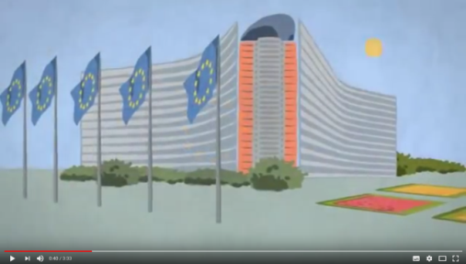
The 4 roles of the Commission
RIGHT OF INITIATIVE
POLICY & BUDGET IMPLEMENTATION
GUARDIAN OF THE TREATIES
INTERNATIONAL DIMENSION
https://www.youtube.com/watch?v=nWpgO1EPO_Y
Notes:
There is a possibility to show the video "The European Commission explained – functioning and tasks"

Slide 7
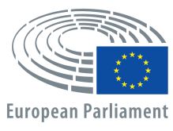
Initiating laws and policies
EU's voice
Proposals
Proposals
Citizens' voice
Member States' voice
Notes:
Initiating laws & policies
- The Commission has the right to propose new laws and policies on the matters contained in the treaties.
- It can also be asked to make a proposal – by the Council, the European Parliament, EU citizens, the European Investment Bank, European Central Bank and EU governments.
How EU decisions are made
The EU’s standard decision-making procedure is known as 'Ordinary Legislative Procedure’ (ex "codecision"). This means that the directly elected European Parliament has to approve EU legislation together with the Council (the governments of the 28 EU countries).
Drafting EU law
Before the Commission proposes new initiatives it assesses the potential economic, social and environmental consequences that they may have. It does this by preparing 'Impact assessments' which set out the advantages and disadvantages of possible policy options.
The Commission also consults interested parties such as non-governmental organisations, local authorities and representatives of industry and civil society. Groups of experts give advice on technical issues. In this way, the Commission ensures that legislative proposals correspond to the needs of those most concerned and avoids unnecessary red tape.
Citizens, businesses and organisations can participate in the consultation procedure via the website Public consultations.
National parliaments can formally express their reservations if they feel that it would be better to deal with an issue at national rather than EU level.
Review and adoption
The European Parliament and the Council review proposals by the Commission and propose amendments. If the Council and the Parliament cannot agree upon amendments, a second reading takes place.
In the second reading, the Parliament and Council can again propose amendments. Parliament has the power to block the proposed legislation if it cannot agree with the Council.
If the two institutions agree on amendments, the proposed legislation can be adopted. If they cannot agree, a conciliation committee tries to find a solution. Both the Council and the Parliament can block the legislative proposal at this final reading.
Institutional triangle
- There are 3 institutions responsible for EU law-making :
- European Commission
- European Parliament
- Council of the European Union
European Parliament
Tasks:
Adopts and negotiates, jointly with the Council of the EU, proposals for legislation put forward by the Commission (codecision)
Controls and approves, together with the Council of the EU, the EU budget
Oversees the work of the Commission
- Current term: 751 MEPs from 28 countries, elected for 5 years in May 2014.
Council of the European Union
Tasks:
Adopts and negotiates, jointly with the European Parliament, proposals for legislation put forward by the Commission (codecision)
Adopts, jointly with the European Parliament, the EU budget
Coordinates national policies
Develops the EU's common foreign and security policy, on the basis of guidelines set by the European Council
4.1) Ensures the unity, consistency and effectiveness, together with the High Representative, of the EU's foreign policy
Concludes international agreements
- Consists of national ministers from each EU country
- Its work is directed by a different EU member country every 6 months. The country doing this is said to hold the presidency of the Council
- To make this task easier, this country is helped by the preceding and successor presidency holders
- This group of 3 countries (the 'trio') works together closely, coordinating longer-term goals and preparing a common agenda of major issues to be addressed by the Council over an 18 month period.
Committee of the Regions
The Committee of the Regions (CoR) consists of representatives of regional and local government.
They are proposed by the Member States and appointed by the Council for a 5‑year term.
The Council and Commission must consult the CoR on matters of relevance to the regions, and it may also issue opinions on its own initiative.
European Economic and Social Committee
The European Economic and Social Committee (EESC) is a consultative body that gives representatives of Europe's socio-occupational interest groups and others, a formal platform to express their points of views on EU issues.
Its members are appointed by the Council for a 5-year term.
Its opinions are forwarded to the Council, the European Commission and the European Parliament.

Slide 8
The 4 roles of the Commission
RIGHT OF INITIATIVE
POLICY & BUDGET IMPLEMENTATION
GUARDIAN OF THE TREATIES
INTERNATIONAL DIMENSION

Slide 9
Voted EU Budget 2018
Expenditure
Economic, social & territorial cohesion 35%
Competitiveness for growth & jobs 14%
22 bn
55.5 bn
Total budget
€160 bn
(2018)
Security & Citizenship 2%
3.5 bn
Global Europe 6%
9.5 bn
1%
Administration 6%
9.5 bn
59 bn
Sustainable growth: natural resources 37%
Revenue
Expenditure is expressed in commitments, revenues correspond to payments level
GNI
VAT
Import duties on non-EU products
Other
Source: European Commission
Notes:
Budget:
The Commission draws up annual budgets for approval by the Parliament and Council.
The Commission sets EU spending priorities, together with the Council and Parliament.
The Commission supervises how the money is spent, under scrutiny by the Court of Auditors. Around 75 % of the Budget is spent under shared management arrangements together with Member States, 17 % in direct management by the Commission and executives agencies, and 8% in indirect management (third countries or the bodies they have designated, international organisations and their agencies, the European Investment Bank (EIB) and the European Investment Fund (EIF) etc.)
The Commission leads the execution of the full budgetary cycle.
Total budget (2018): €160 bn in total commitments.
The budget is results-oriented; it is not an accounting tool, but a means to achieve the EU's political goals, e.g.:
Excellence in Research and Innovation
Effective common climate action
Creating jobs and growth via the Structural and Investment Funds or Juncker's Investment Plan
More sustainable, secure and affordable energy via the Energy Union strategy
Tackling the refugee crisis via the Agenda on Migration
Pie chart:
EU institutions agreed that in 2018 the EU will devote € 160 billion to implement European policies. This represents about 1% of EU Gross National Income (GNI).
Strengthening the European economy and fostering job creation remains an overarching priority. Therefore, the largest share of the money will be invested in growth, employment and competitiveness. More funds will be provided also for the second top priority: to efficiently address the challenges posed by the refugee influx, to tackle the root causes of migration and to reinforce security within Europe’s borders.
Smart and inclusive growth (77.5 bn):
€22 bn on growth, employment and competitiveness
- for research, innovation and education programmes Horizon 2020 and Erasmus+
- for small and medium enterprises programme COSME, Connecting Europe Facility and to underpin the European Fund for Strategic Investments
€55.5 bn for the EU Structural and Investment Funds
- to support productive investments and structural reforms
to foster convergence among Member States and regions
Two digit growth rates for top priorities
Two digit growth rates are provided to a number of top priorities:
Nearly €4.1 billion will be dedicated to managing migration and tackling security challenges in 2018.
With the bulk of funding already frontloaded, the total for these policy areas will amount to €22 billion in the 2015-2018 period. The money helps member states to resettle refugees, create reception centres, integrate persons who have the right to stay and return those who don't; it contributes to enhancing border protection, stepping up crime prevention and counter terrorism activities and protecting critical infrastructure.
€22 billion in commitments are mobilised to boost economic growth and create new jobs under sub-heading 1a (competitiveness for growth and jobs); this is an increase of around 3% compared to 2017; this part of the budget covers instruments such as Erasmus + which increases by 12% to €2.3 billion and the European fund for strategic investments which amounts to €2 billion.
More money for young people
Besides the significant increase for Erasmus +, the 2018 EU budget also delivers on a number of other measures that benefit young people in particular. This includes the youth employment initiative for which an additional €350 million is available to help young people find a job. The 2018 EU budget also allows the Commission to start an initiative to help young people to travel and discover other European countries.
Revenues:
According to the equilibrium principle, total revenue must cover budgeted expenditure at the level of payment appropriations. Ex.: 2018: EUR 145 billion (144.755917104 billion)
How is the budget financed ? Where does the money come from?
Own resources
The bulk of the EU income stems from ‘own resources’, which are funds that belong to the EU and are collected on its behalf by Member States. The own resources can be divided into the following categories:
Traditional own resources (TOR): consist mainly of customs duties on imports from outside the EU. EU Member States keep 20 % of the amounts as collection costs.
Own resources based on value added tax (VAT): a uniform rate of 0.3 % is levied on the harmonised VAT base of each Member States. (Nota bene: the VAT base is only notionally/artificially harmonized for the purpose of calculating the own resources).
Own resources based on GNI: each Member State transfers a uniform percentage of its GNI to the EU. Although initially designed simply to cover the balance of total expenditure not covered by the other own resources, this category of own resources has become the largest source of revenue of the EU budget.
The VAT-based and GNI-based own resources are also considered and summarized as 'national contributions' in the budgetary documents.
A small part of this amount is covered by 'other revenue' (taxes levied on the salaries of EU staff, interests on late payments and fines, contributions from non-EU countries to certain programmes, treasury surplus from previous year, etc).
The total amount of own resources cannot exceed 1.20 % of EU GNI.
The rules for determining the composition of revenue are laid down in the ‘Own Resources Decision’ which is the main legal base for the EU budgetary income. The current decision was agreed on 26 May 2014. Subsequently, it was ratified by all Member States (involving also national parliaments) and entered into force on 1 October 2016 with retroactive effect from 1 January 2014.
There are also several correction mechanisms enshrined in the own resources decision, most notably the so-called UK rebate to compensate the UK for excessive budgetary imbalances and lump-sum reductions on the GNI-contributions for certain Member States.
Some Member States may choose not to participate in certain justice and home affairs policies. Their own resources payments are adjusted accordingly. This has been done since 2003 for Denmark and since 2006 for Ireland and the United Kingdom.
Traditional own resources (customs duties and sugar levies)
Traditional own resources (TOR) are levied on economic operators and collected by Member States on behalf of the EU. These payments accrue directly to the EU budget, after a 20% deduction that Member States retain as collection costs. Customs duties are levied on imports of agricultural and non-agricultural products from non-EU countries, at rates based on the Common Customs Tariff.
In 2016, the EU’s revenue from customs duties was EUR 19 961 million (13.85 % of its total revenue). A production charge paid by sugar producers brought revenue of EUR 133 million. Total revenue from traditional own resources (customs duties and sugar levies) was EUR 20 094 million (13.95 % of the EU’s total revenue). The shares in the pie chart are based on the figures budgeted for the adopted Budget 2017. In as far as these figures are based on forecasts and estimates, they will be adjusted in the course of the annual procedures.
VAT own resource
The VAT bases of all Member States are first (notionally) harmonised in accordance with EU rules. They are then capped at 50% of the GNI base (in order to remedy the regressive aspects of the VAT-based resource). Finally, a uniform rate of 0.3 is levied on each Member State’s harmonised VAT base.
In 2016, four Member States saw their VAT contribution reduced thanks to this 50 % cap (Croatia, Cyprus, Luxembourg and Malta).
The EU’s total revenue from the VAT own resource was EUR 15 895 million (11 % of total revenue) in 2016.
Gross national income own resource
The GNI own resource was introduced in 1988 to allow for the balancing of budget revenue and expenditure, i.e. to finance the part of the budget not covered by other revenue. The amount of the GNI own resource needed therefore depends on the difference between total expenditure and the sum of all other revenue.
A uniform call rate is applied to each Member States’ GNI, established in accordance with EU rules. The rate is fixed as part of the budgetary procedure.
In 2016, the rate of call of GNI was 0.6514257 ⁽²⁾ and the total amount of the GNI resource levied was EUR 95 578 million (representing 66.3 % of total revenue). However, this rate is subject to re-adjustments several times in the course of budget execution (whenever the level of payment appropriation or the amounts of the other budgeted revenue items change, the level of the GNI-based own resource has to be fine-tuned).

Slide 10
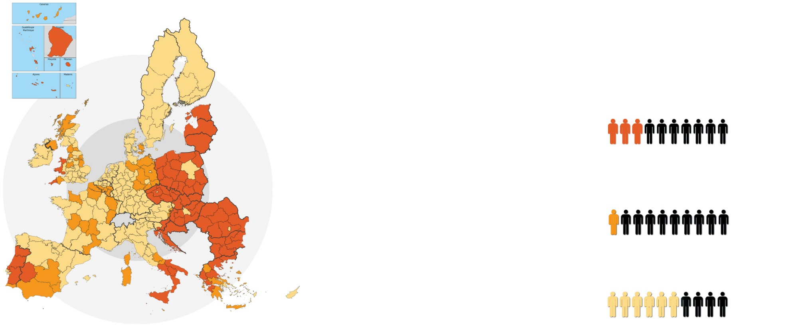
Implementing policies – regional policy
ALL EU REGIONS BENEFIT
€ 181 billion
for less developed regions
LEVEL OF INVESTMENT
GDP < 75% of EU-27 average
50.9%
27% of EU pop.
ADAPTED TO
€38bn
for transition regions
LEVEL OF DEVELOPMENT
GDP 75-90% of EU-27 average
10.7%
12% of EU pop.
€57bn
for more developed regions
GDP > 90% of EU-27 average
61% of EU pop.
16.1%
Notes:
Policy Implementation
As the European Union’s executive body, the Commission is responsible for managing and implementing the EU budget and the policies and programmes adopted by the Parliament and the Council. Most of the actual work and spending is done by national and local authorities but the Commission is responsible for supervising it.
Example: Regional Policy
Regional Policy targets all regions and cities in the European Union in order to support job creation, business competitiveness, economic growth, sustainable development, and improve citizens’ quality of life.
Its investments help to deliver many EU policy objectives and complements EU policies such as those dealing with education, employment, energy, the environment, the single market, research and innovation.
The European Structural and Investment Funds are directly contributing to the Investment Plan and the Commission's priorities.
The policy is implemented by national and regional bodies in partnership with the European Commission.
Cohesion policy
‘Cohesion policy’ is the policy behind the hundreds of thousands of projects all over Europe that receive funding
Economic and social cohesion – as defined in the 1986 Single European Act – is about ‘reducing disparities between the various regions and the backwardness of the least-favoured regions’. The EU's most recent treaty, the Lisbon Treaty, adds another facet to cohesion, referring to ‘economic, social and territorial cohesion’.
Cohesion policy covers every region in the EU. However, most of the funds are targeted where they are most needed: at regions with a GDP per capita under 75% of the EU average.
€ 351.8 billion – almost a third of the total EU budget – has been set aside for Cohesion Policy for 2014-2020.

Slide 11
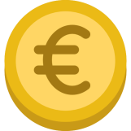
Implementing policies – regional policy - results 2007-2013
€346.5bn support provided
1 000 000 jobs created – 1/3 of net job created in the EU
250,000 SMEs supported
5,000 km of new or reconstructed railroads
30,000 km of new or reconstructed roads
Broadband access for 8.2 million more citizens
5.9 million more people connected to new/improved supply of clean drinking water.
ESF: 15 million participants per year in training
Notes:
Expected results for the 2014-2020 period:
2 million companies will be directly supported
15 million households will have access to high-speed broadband thanks to ERDF
Decrease of estimated annual greenhouse gas emissions of around 30 million tons of CO2
€120 billion will be allocated to employment, social inclusion, education and training

Slide 12
The 4 roles of the Commission
RIGHT OF INITIATIVE
POLICY & BUDGET IMPLEMENTATION
GUARDIAN OF THE TREATIES
INTERNATIONAL DIMENSION

Slide 13
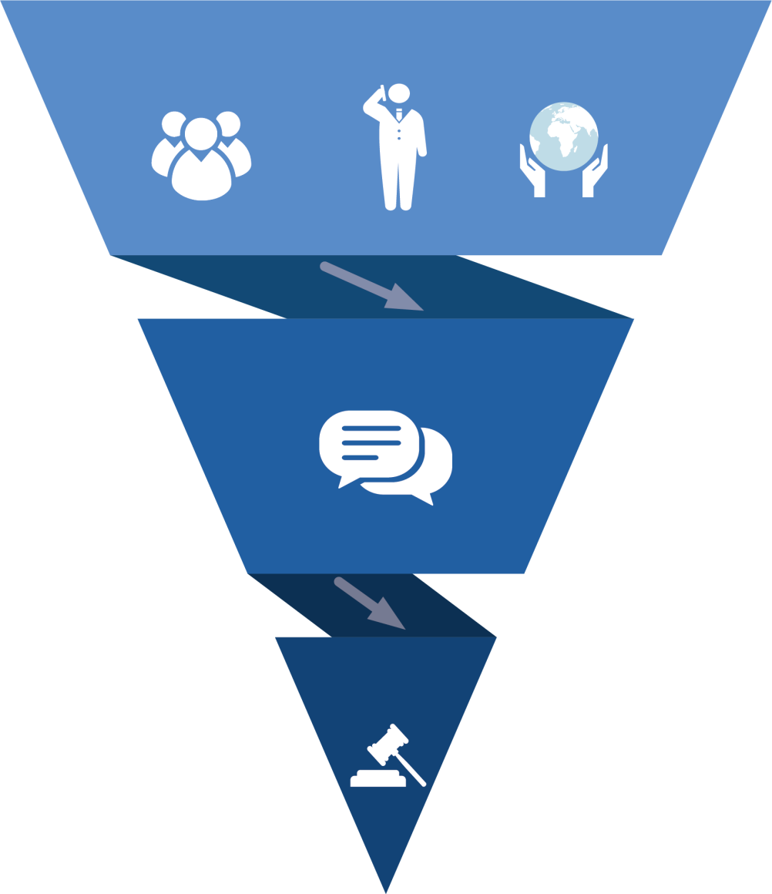
Guardian of the treaties – infringement procedure
I.
Opening a case
- Complaints registered
- Own-initiative cases opened by the Commission
Public
Business
NGOs
II.
Dialogue with Member States
Formal dialogue:
- via LFN (Art. 258 of TFEU)
- via RO (Art 258 of TFEU)
If useful, via informal dialogue at political level/through EU Pilot
III.
Litigation procedure (referrals to the Court)
Judgements delivered by the Court:
- under Article 258 of TFEU
- under Article 260(2) of TFEU
- under Article 260(3) of TFEU
Notes:
The EU Member States (MS) must apply EU law correctly and timely. The European Commission (EC) acts as a Guardian of the Treaty (TFEU) and oversees the application of EU law under the supervision of the Court of Justice of the European Union (the Court).
Initial phase
Detection of possible MS’s non-compliance with EU law (by the EC itself and/or by means of complaints from members of the public, businesses, NGOs, other organisations and petitions of the European Parliament).
- own initiative cases launched by the EC.
- complaints.
2) Dialogue with Member States
- If a MS fails to resolve the alleged breach of Union law, the EC may launch a formal infringement procedure (Art 258 of TFEU).
Types of issues:
- non-conformity and/or incorrect/bad application or
- failure to notify national provisions transposing directives.
If useful, the EC and a MS may engage in an informal dialogue at political level/through EU Pilot to find a solution compliant with EU law.
3) Pre-litigation phase
- The EC requests a MS to comment on non-compliance issue, typically within two months by sending a letter of formal notice (Art 258 of TFEU).
- If no satisfactory reply has been received from a MS concerned, the EC requests the MS to comply within a given time limit by sending a reasoned opinion (Art 258 of TFEU).
4) Referrals to the Court
If no satisfactory reply has been received from the MS, the EC brings this MS before the Court (referral to the Court, Art 258 of TFEU).
- If the MS still does not comply, the EC launches a 2nd infringement procedure by sending a 2nd letter of formal notice. In a 2nd judgement, the Court may, on the basis of a proposal from the EC, impose lump sum and/or a daily penalty payment on a MS concerned (Art 260 (2) of TFEU).
- In cases of failure to transpose EU legislative directives into national law on time, the EC may propose penalty payments without the need for a 2nd judgement (Article 260(3) of TFEU).
- Every year, the EC publishes a report on monitoring the application of EU law. The report examines how well EU law was applied, the challenges faced, in each Member State and policy area and provides a statistical overview of the infringement procedures launched by the EC (available here: https://ec.europa.eu/info/publications/annual-reports-monitoring-application-eu-law_en).

Slide 14
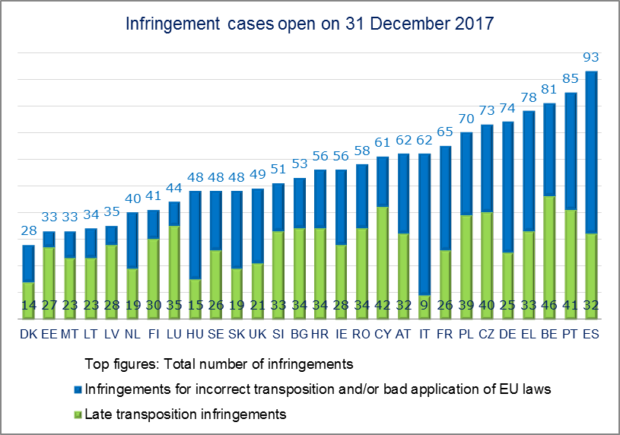
Guardian of the treaties / Member States
Number of infringement cases in EU-28 in 2017
Infringement cases open on 31 December 2017
Top figures: Total number of infringements
Infringements for incorrect transposition and/or bad application of EU laws
Late transposition infringements
Notes:
Guardian of the Treaties
The Commission ensures that the EU treaties and the laws derived from them are upheld.
If a possible infringement of EU law is identified by the Commission or reported in a complaint, the Commission attempts to quickly resolve the underlying problem with the government concerned by means of a structured dialogue.
If the government does not agree with the Commission, or fails to implement a solution to rectify the suspected violation of EU law, the Commission can launch a formal infringement procedure.
This can involve the Commission taking the country to the Court of Justice and ask to impose lump sum and/or penalty payment.
Example: Open infringement cases in EU-28 on 31 December 2017

Slide 15
Guardian of the treaties – companies
Google
Fined €2.6 billion
Apple
€13 billion in Illegal state aid to be recovered by Ireland
Notes:
Competition
EU competition rules aim to ensure that all companies compete fairly and equally in the single market to the benefit of consumers, businesses and the European economy as a whole. Together with national competition authorities and national courts, the European Commission enforces EU competition policy and rules to ensure that companies compete fairly with each other. This helps to reduce prices and improve quality, encourages innovation and efficiency, and creates a wider choice for consumers.
The Commission takes action in regard to:
cartels or other illegal arrangements between companies to avoid competing with each other or to set artificially high prices;
abuse of a dominant position, whereby a major player tries to squeeze competitors out of the market;
mergers and similar agreements between companies that may affect competition in the Single Market;
financial support (state aid) from EU governments to companies, which may distort competition in the Single Market by favouring some companies over others; and
promoting competition culture internationally.
EU investigations into anti-competitive practices can cover not only goods but also professions and services. The Commission monitors the assistance Member State governments give to business (state aid) to ensure that it does not give certain companies an unfair advantage over their competitors. This helps make Europe fairer and promotes growth. State aid may be allowed if it helps or promotes disadvantaged regions, small and medium-sized businesses, research and development, environmental protection, training, employment or culture.
In 2016, the Commission found that Ireland granted undue tax benefits of up to €13 billion to Apple. This is illegal under EU state aid rules, because it allowed Apple to pay substantially less tax than other businesses. Ireland must now recover the illegal aid.
There are many other examples of EU investigations bearing fruit for consumers and taxpayers: In 2016 and 2017 the Commission fined the members of a truck producers cartel that had lasted 14 years. It involved six leading truck producers: Scania, Daimler, DAF, Iveco, MAN and Volvo/Renault. Together, these companies produce more than 9 out of every 10 medium and heavy trucks sold in Europe. The Commission fined the 6 companies a total of €3.8 billion – a record fine for a cartel in the EU's 60 year history. This money goes into the EU budget, thereby reducing the amount needed to be contributed by taxpayers.
Big firms are barred from using their bargaining power to impose conditions that would make it difficult for their suppliers or customers to do business with their competitors. In 2017, the Commission fined Google €2.42 billion for abusing its market dominance as a search engine by promoting its own comparison shopping service in its search results, and demoting those of competitors.
More information: https://ec.europa.eu/info/topics/competition_en Twitter @EU_Competition

Slide 16
The 4 roles of the Commission
RIGHT OF INITIATIVE
POLICY & BUDGET IMPLEMENTATION
GUARDIAN OF THE TREATIES
INTERNATIONAL DIMENSION

Slide 17
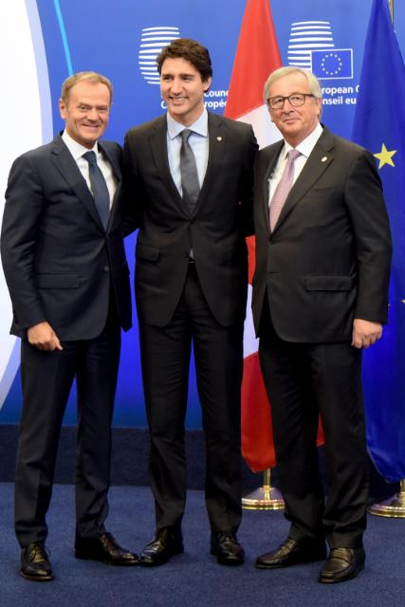
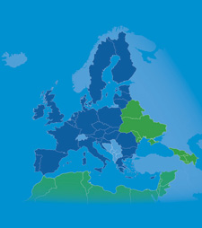
Representing the EU in the world
Neighbourhood
Policy &
Enlargement
Negotiations
Development
cooperation &
humanitarian aid
Common
Foreign and Security Policy
International
agreements
Notes:
International agreements
The Commission represents the EU during negotiations, in particular in areas of trade policy and humanitarian aid, except where the agreement relates to foreign and security policy, when the EU is represented by the High Representative.
The EU negotiates agreements through its world-wide network of trade relations. It engages with a huge range of partners, mostly through free trade agreements.
These partnerships seek to create growth and jobs for Europeans by opening new markets with the rest of the world.
EU trade policy also aims to reduce child and forced labour, environmental destruction and price volatility. Schemes which ensure transparency and traceability in supply chains are one example.
For the world's poorest countries, EU trade policy looks to combine trade and development. Allowing lower duties, supporting small export businesses, and advising on improvements to governance are just some of the ways trade and development can work hand in hand to ensure the neediest benefit from trade-led growth.
EU's assistance to developing countries
The Commission's Directorate-General for International Cooperation and Development (DG DEVCO) is responsible for designing European international cooperation and development policy and delivering aid throughout the world.
DG DEVCO is in charge of development cooperation policy in a wider framework of international cooperation, adapting to the evolving needs of partner countries. This encompasses cooperation with developing countries at different stages of development, including with countries graduated from bilateral development assistance to cover the specific needs of these countries during the transition period between low income countries and upper middle income countries. DG DEVCO works closely with other Commission services responsible for thematic policies, as well as with the European External Action Service and Commission services on external action, so as to facilitate and help ensure a consistent approach.
DG DEVCO is responsible for formulating European Union development policy and thematic policies in order to reduce poverty in the world, to ensure sustainable economic, social and environmental development and to promote democracy, the rule of law, good governance and the respect of human rights, notably through external aid. DG DEVCO fosters coordination between the European Union and its Member States in the area of development cooperation and ensure the external representation of the European Union in this field.
European Neighbourhood Policy
The European Neighbourhood Policy (ENP) governs the EU's relations with 16 of its southern and eastern neighbours.
To the South: Algeria, Egypt, Israel, Jordan, Lebanon, Libya, Morocco, Palestine (this designation does not entail any recognition of Palestine as a state and is without prejudice to positions on the recognition of Palestine as a state), Syria and Tunisia.
To the East: Armenia, Azerbaijan, Belarus, Georgia, Moldova and Ukraine.
Designed to strengthen the EU’s relations with its neighbours, the policy’s main objectives are to:
Stabilise neighbouring countries through addressing economic development, employability and youth, transport and energy connectivity, migration, mobility and security;
Promote key EU interests of good governance, democracy, the rule of law and human rights;
Facilitate cooperation at regional level through the Eastern Partnership (EU and Eastern neighbours) and the Union for the Mediterranean (cooperation between the EU and its Southern neighbours),
Enlargement Negotiations
The EU operates comprehensive approval procedures that ensure new members are admitted only when they can demonstrate they will be able to play their part fully as members, namely by:
complying with all the EU's standards and rules
having the consent of the EU institutions and EU member states
having the consent of their citizens – as expressed through approval in their national parliament or by referendum.
Membership criteria – Who can join?
The Treaty on the European Union states that any European country may apply for membership if it respects the democratic values of the EU and is committed to promoting them.
The first step is for the country to meet the key criteria for accession. These were mainly defined at the European Council in Copenhagen in 1993 and are hence referred to as 'Copenhagen criteria'. Countries wishing to join need to have:
stable institutions guaranteeing democracy, the rule of law, human rights and respect for and protection of minorities;
a functioning market economy and the capacity to cope with competition and market forces in the EU;
the ability to take on and implement effectively the obligations of membership, including adherence to the aims of political, economic and monetary union.
The EU also needs to be able to integrate new members.
In the case of the countries of the Western Balkans additional conditions for membership, were set out in the so-called 'Stabilisation and Association process', mostly relating to regional cooperation and good neighbourly relations.
What is negotiated?
The conditions and timing of the candidate's adoption, implementation and enforcement of all current EU rules (the "acquis").
These rules are divided into 35 different policy fields (chapters), such as transport, energy, environment, etc., each of which is negotiated separately.
Other issues discussed:
financial arrangements – such as how much the new member is likely to pay into and receive from the EU budget (in the form of transfers)
transitional arrangements – sometimes certain rules are phased in gradually, to give the new member or existing members time to adapt.
Oversight by the EU institutions
Throughout the negotiations, the Commission monitors the candidate's progress in applying EU legislation and meeting its other commitments, including any benchmark requirements.
This gives the candidate additional guidance as it assumes the responsibilities of membership, as well as an assurance to current members that the candidate is meeting the conditions for joining.
The Commission also keeps the EU Council and European Parliament informed throughout the process, through regular reports, strategy papers and clarifications on conditions for further progress.
Latest member: Croatia - 1 July 2013
Common Foreign and Security Policy
EU foreign and security policy, which has developed gradually over many years, enables the EU to speak and act as one in world affairs. Acting together gives the EU's 28 members far greater clout than they would have if each pursued its own policies.
The 2009 Lisbon Treaty strengthened this policy area by creating
the post of EU High Representative for Foreign Affairs & Security Policy
the European External Action Service (EEAS) – the EU's diplomatic corps.
The EEAS:
The EEAS is the European Union's diplomatic service.
It is led by Federica Mogherini, the EU's High Representative for Foreign Affairs and Security Policy, who is responsible for coordinating and carrying out the EU's foreign and security policy.
Furthermore as Vice-President of the Commission, Mogherini ensures that the EU's external action is consistent across all departments and policy areas.
Formally launched in 2011, the EEAS was created by the Treaty of Lisbon which entered into force on 1 December 2009.
The EEAS manages the EU's response to crises, has intelligence capabilities and cooperates with the Commission in areas where they share power.
Cooperation between the Commission and the EEAS:
The European Commission cooperates with the EEAS on many issues – adopting a comprehensive approach for the EU's foreign policy.
- E.g. this is the case when it comes to EU's assistance to developing countries ('development aid'). But the EEAS is structurally and financially independent from the Commission.
The Commission retained control over its powers in aid (and the €6 billion a year budget for that), development, energy and enlargement (helping potential new member countries to join). This gives the relevant Commissioners the lead in those areas, and they deputise for the HR when necessary.
G7 membership
The EU has regularly taken part in all meetings since the G7 Summit in Ottawa in 1981. It never holds the Presidency, though, and therefore never organises a summit. Nevertheless, the 2014 G7 Summit was hosted by the EU in Brussels. This was on account of Russia’s membership having been suspended, and because Russia originally held the G8 Presidency that year. As one of the world’s most powerful economic areas it is important that the EU takes part in the G7 process. Another factor is the EU’s increased security policy commitment.
The European Union is represented at G7 summits by the incumbent Presidents of the European Commission and of the European Council.
General information:
The EU's international roles
The European Union plays important roles in diplomacy, the promotion of human rights, trade, development and humanitarian aid and working with multilateral organisations. The role of the EEAS is to try and bring coherence and coordinating to the European Union's international role.
The Lisbon Treaty sets out clearly what should guide the European Union internationally.
"The Union's action on the international scene shall be guided by the principles which have inspired its own creation, development and enlargement, and which it seeks to advance in the wider world: democracy, the rule of law, the universality and indivisibility of human rights and fundamental freedoms, respect for human dignity, the principles of equality and solidarity, and respect for the principles of the United Nations Charter and international law."
Here are a few examples of the roles the EU plays beyond its borders:
Contributor to peace
Internationally, the EU has led and supported peace talks around the world to facilitate solutions in conflicts worldwide such as for example:
In July 2015, following years of EU-led diplomacy, a historic international agreement was reached on Iran’s nuclear programme. The EU, together with China, France, Germany, Russia, the United Kingdom and the United States, brokered the agreement. Iran pledged that under no circumstances would it ever seek, develop or acquire nuclear weapons. The EU now chairs the Committee overseeing the implementation of this agreement.
-Colombia, the EU is supporting peace talks between the Government and the FARC movement to end decades of civil war through the appointment of a special peace envoy -former Irish Foreign Minister Eamon Gilmore.
-In Mali, the EU has been helping the country emerge from a profound political crisis through co-mediated the the Malian Peace agreement which was signed in June 2015. The EU is also helping to train the Malian armed forces to fight terrorism and through substantial development aid. This is an example of the EU's comprehensive approach which uses all its tools - diplomatic, security, financial and with development cooperation .
Through its political, practical and economic support, the EU has played a crucial role in building peace in the Western Balkans since the Yugoslav wars. One example is the dialogue facilitated by the European Union between Serbia and Kosovo, which led to a landmark deal in April 2013 and which is currently being implemented with the support of the EU.
A responsible neighbour
To the east and south of the European Union lie many countries which have undergone – or are still undergoing – dramatic political change. To accompany their transition to fully-fledged democracy, the European Neighbourhood Policy aims to maintain solid and friendly relations with countries at the European Union's borders. Promoting democracy, good governance and human rights while opening trade and cooperating in many policy areas, including on migration and visa issues are some of the Policy's aims.
Development partner
The EU is the largest single donor of development aid. Together, the EU and its member states provide more than half of official development assistance (ODA) globally. This contribution makes a huge difference to millions of people's livelihoods around the world. Against this background, the EU has been a major supporter of the new UN Sustainable Development Goals agreed in 2015 and is committed to their implementation.
Human rights policy
The EU has made human rights a central aspect of its foreign relations and expresses this focus in political dialogues with third countries, in its development policy and aid, and in its participation in multilateral forums, such as the United Nations. The EU also has human rights policy guidelines covering areas such as the death penalty, torture and freedom of expression offline and online. The EU's Instrument for Democracy and Human Rights (EIDHR) enhances respect for human rights and fundamental freedoms in countries and regions where they are most at risk. The right to vote is a human right. Election observation is a vital EU activity which aims to promote democracy, human rights and the rule of law worldwide.
Partner to the United Nations
The EU works closely with the United Nations on a host of issues. The EU's belief in multilateralism reflects an attachment to negotiated, binding rules in international relations. The EU's relation with the United Nations is explicitly spelled out in the Treaty of Lisbon.
Contributing to global security
Under the Common Security and Defence Policy (CSDP), the EU operates civilian and military missions worldwide. These missions carry out a variety of tasks, ranging from managing borders to training local police. The EU Naval Force Operation "Atalanta" off the coast of Somalia, for example, tackles piracy and protects humanitarian shipments of the World Food Programme. In the Mediterranean, the EU has launched Operation "Sophia" as part of the wider EU efforts to disrupt the business model of human smuggling and trafficking networks in the Southern Central Mediterranean and prevent the further loss of life at sea.
Crisis Response & Humanitarian Aid
The EU and its member states are the world's largest donor of humanitarian aid. They provide life-saving aid to the victims of disasters, refugees and others in dire need. Humanitarian aid is provided according to vulnerability criteria and needs assessments. This work is coordinated by the European Commission’s Humanitarian Aid and Civil Protection department (ECHO).
The European Union responds in a coordinated way to international emergencies of all kinds such as for example the recent earthquake in Ecuador, or refugees fleeing the war in Syria, where the EU has been the largest donor of humanitarian aid to the victims of the conflict in Syria.
Advocate of action on climate change
The EU has been at the forefront of international efforts to combat climate change and was instrumental in securing the first-ever universal, legally binding global climate deal adopted at the Paris climate conference (COP21) in December 2015. The EU engages strategic partner countries in dialogue and cooperation to secure ambitious follow-up on Paris commitments. In addition, the EU and Member States together are the largest contributor of climate finance to developing countries.
Trading bloc
The European Union is the world’s largest trading bloc. Trade is a common policy, which means that international trade agreements are negotiated and signed by the EU rather than by individual member states. This allows the EU to speak with a single voice with international partners as it works to promote a free and fairer international trading system.

